Slide 1

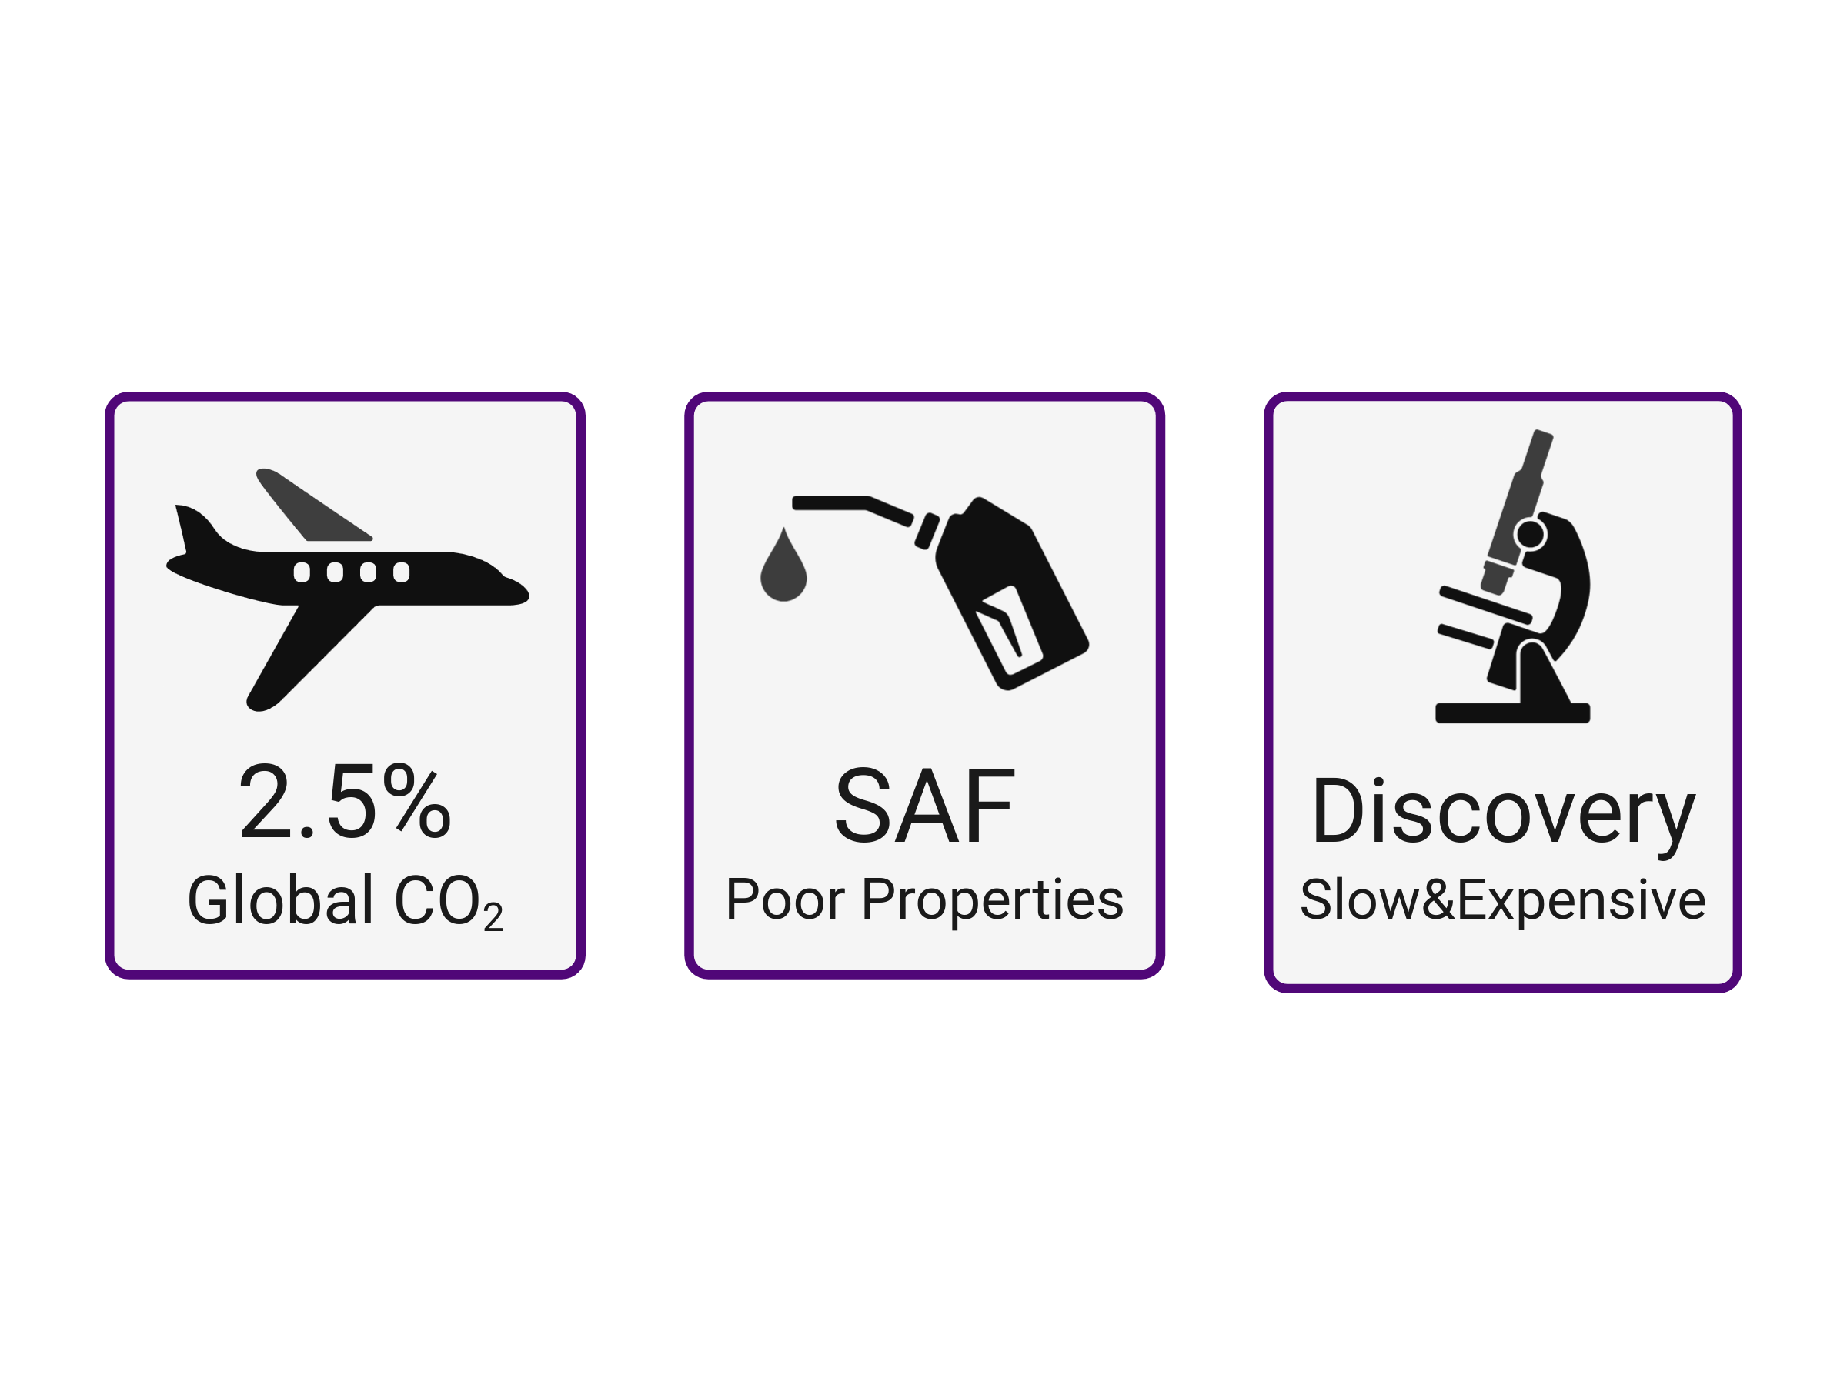
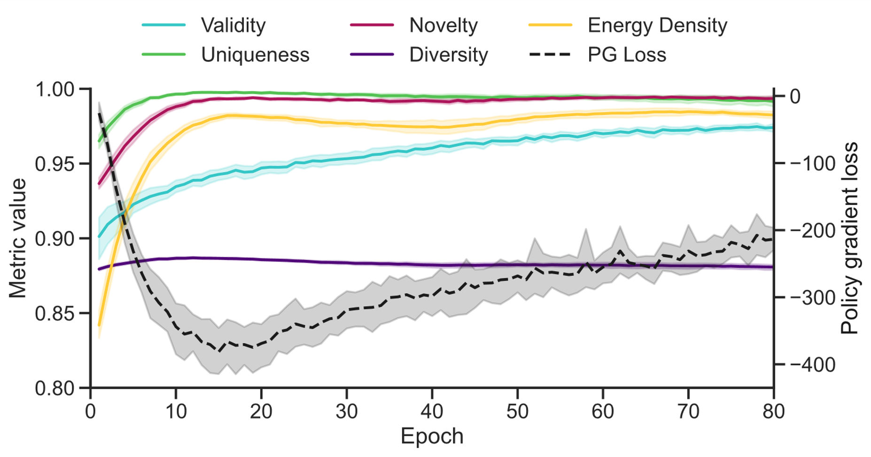
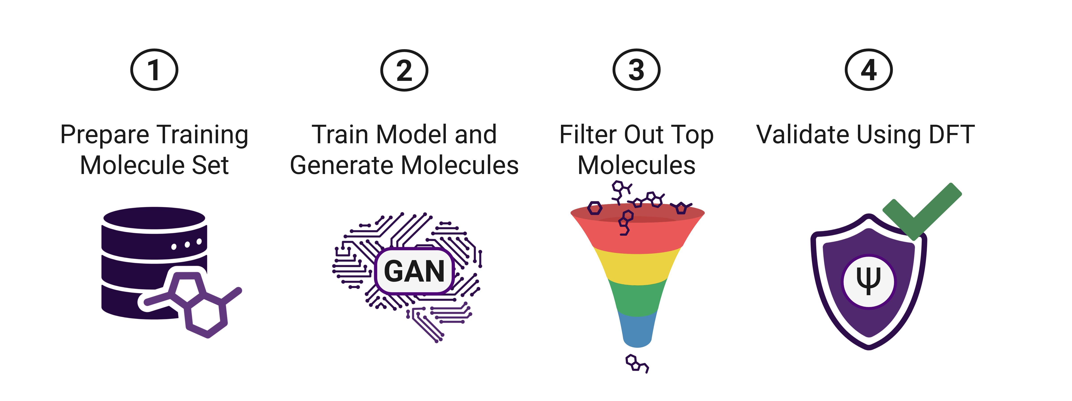
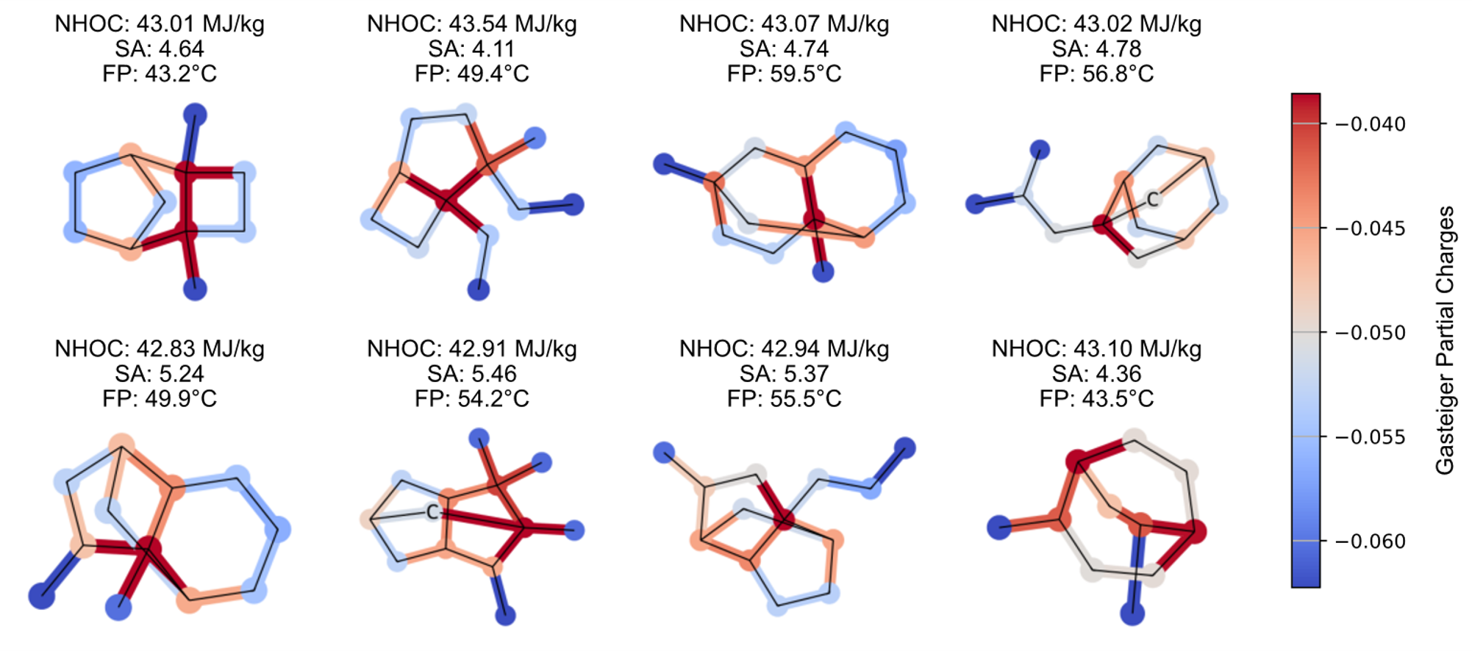
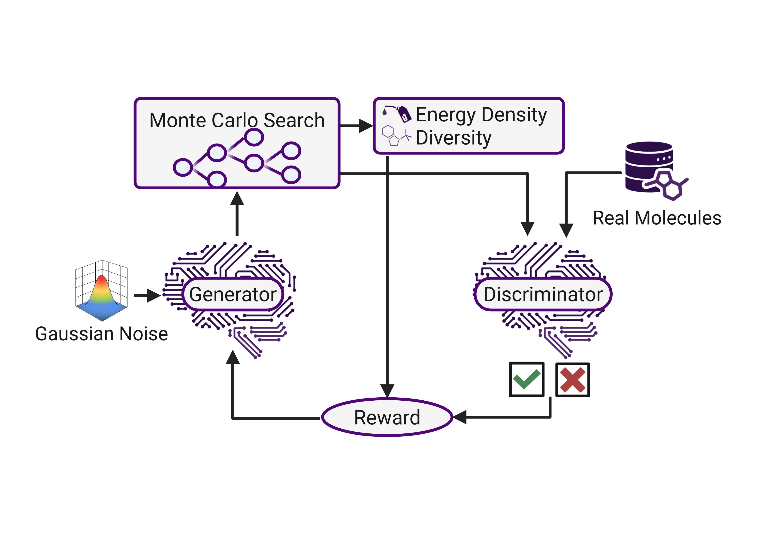
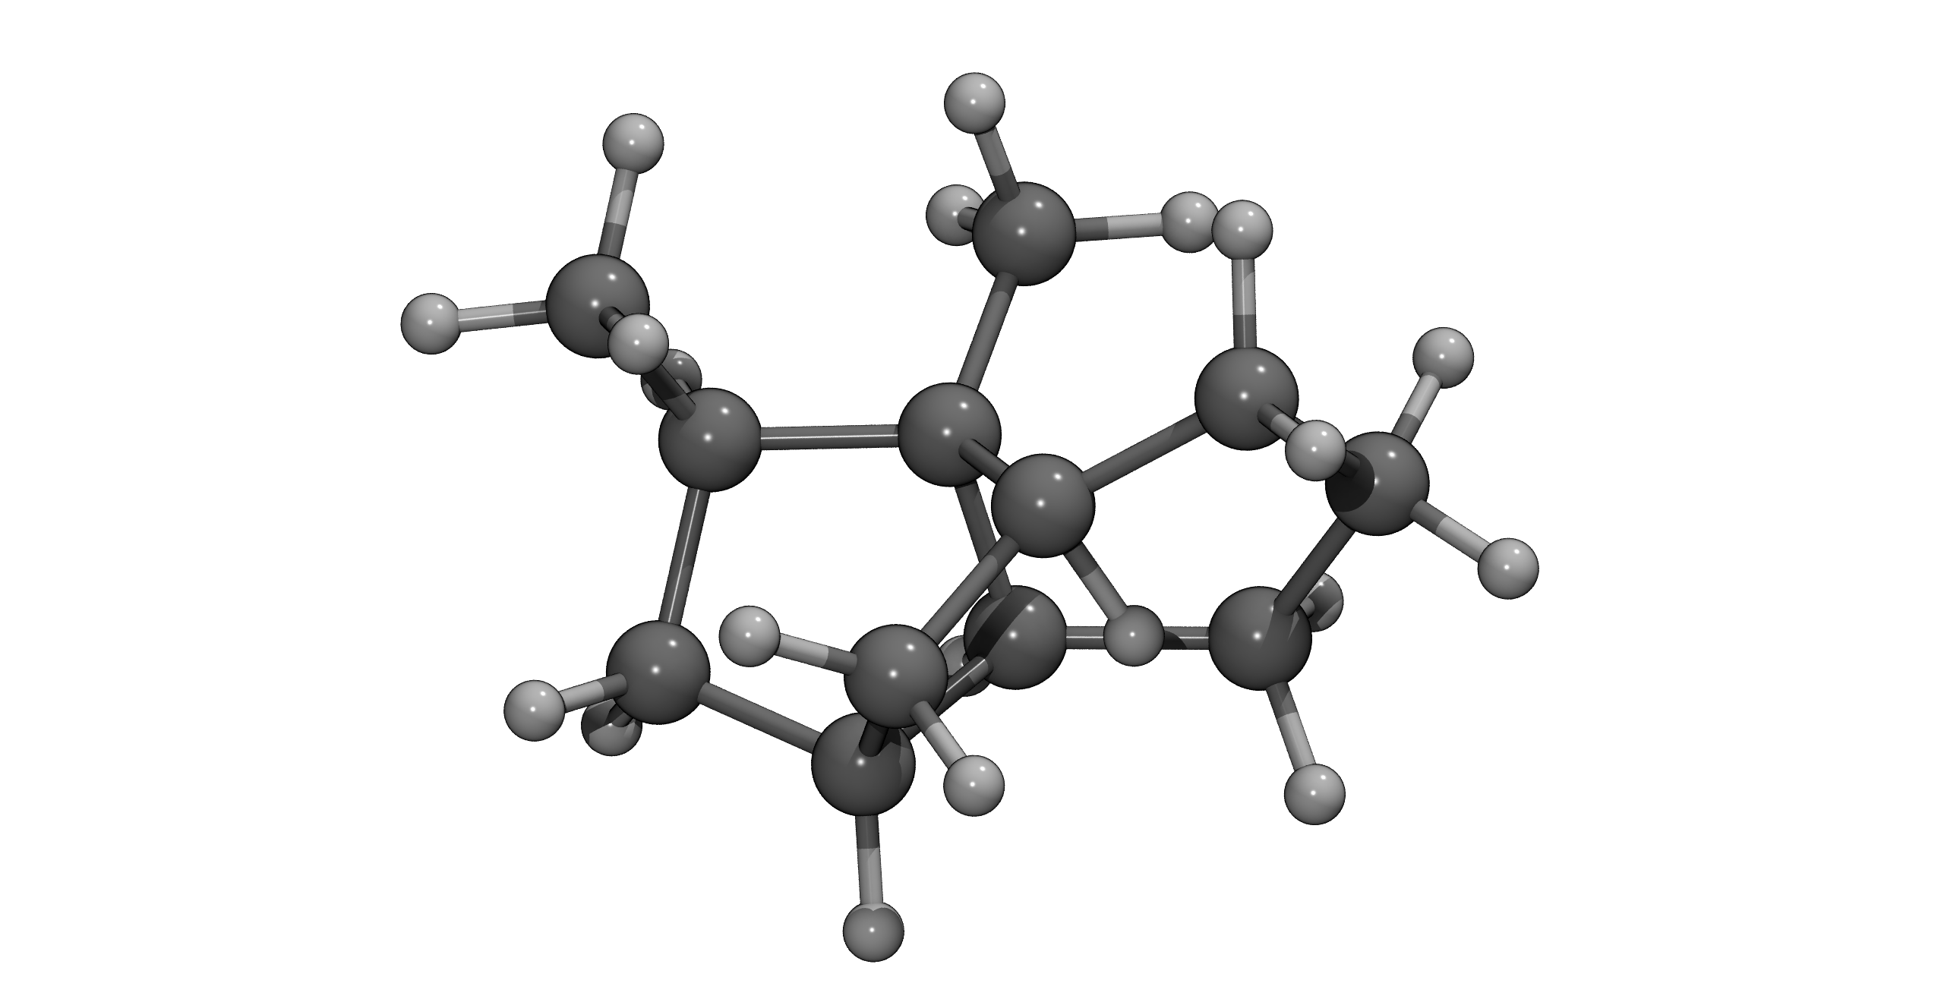
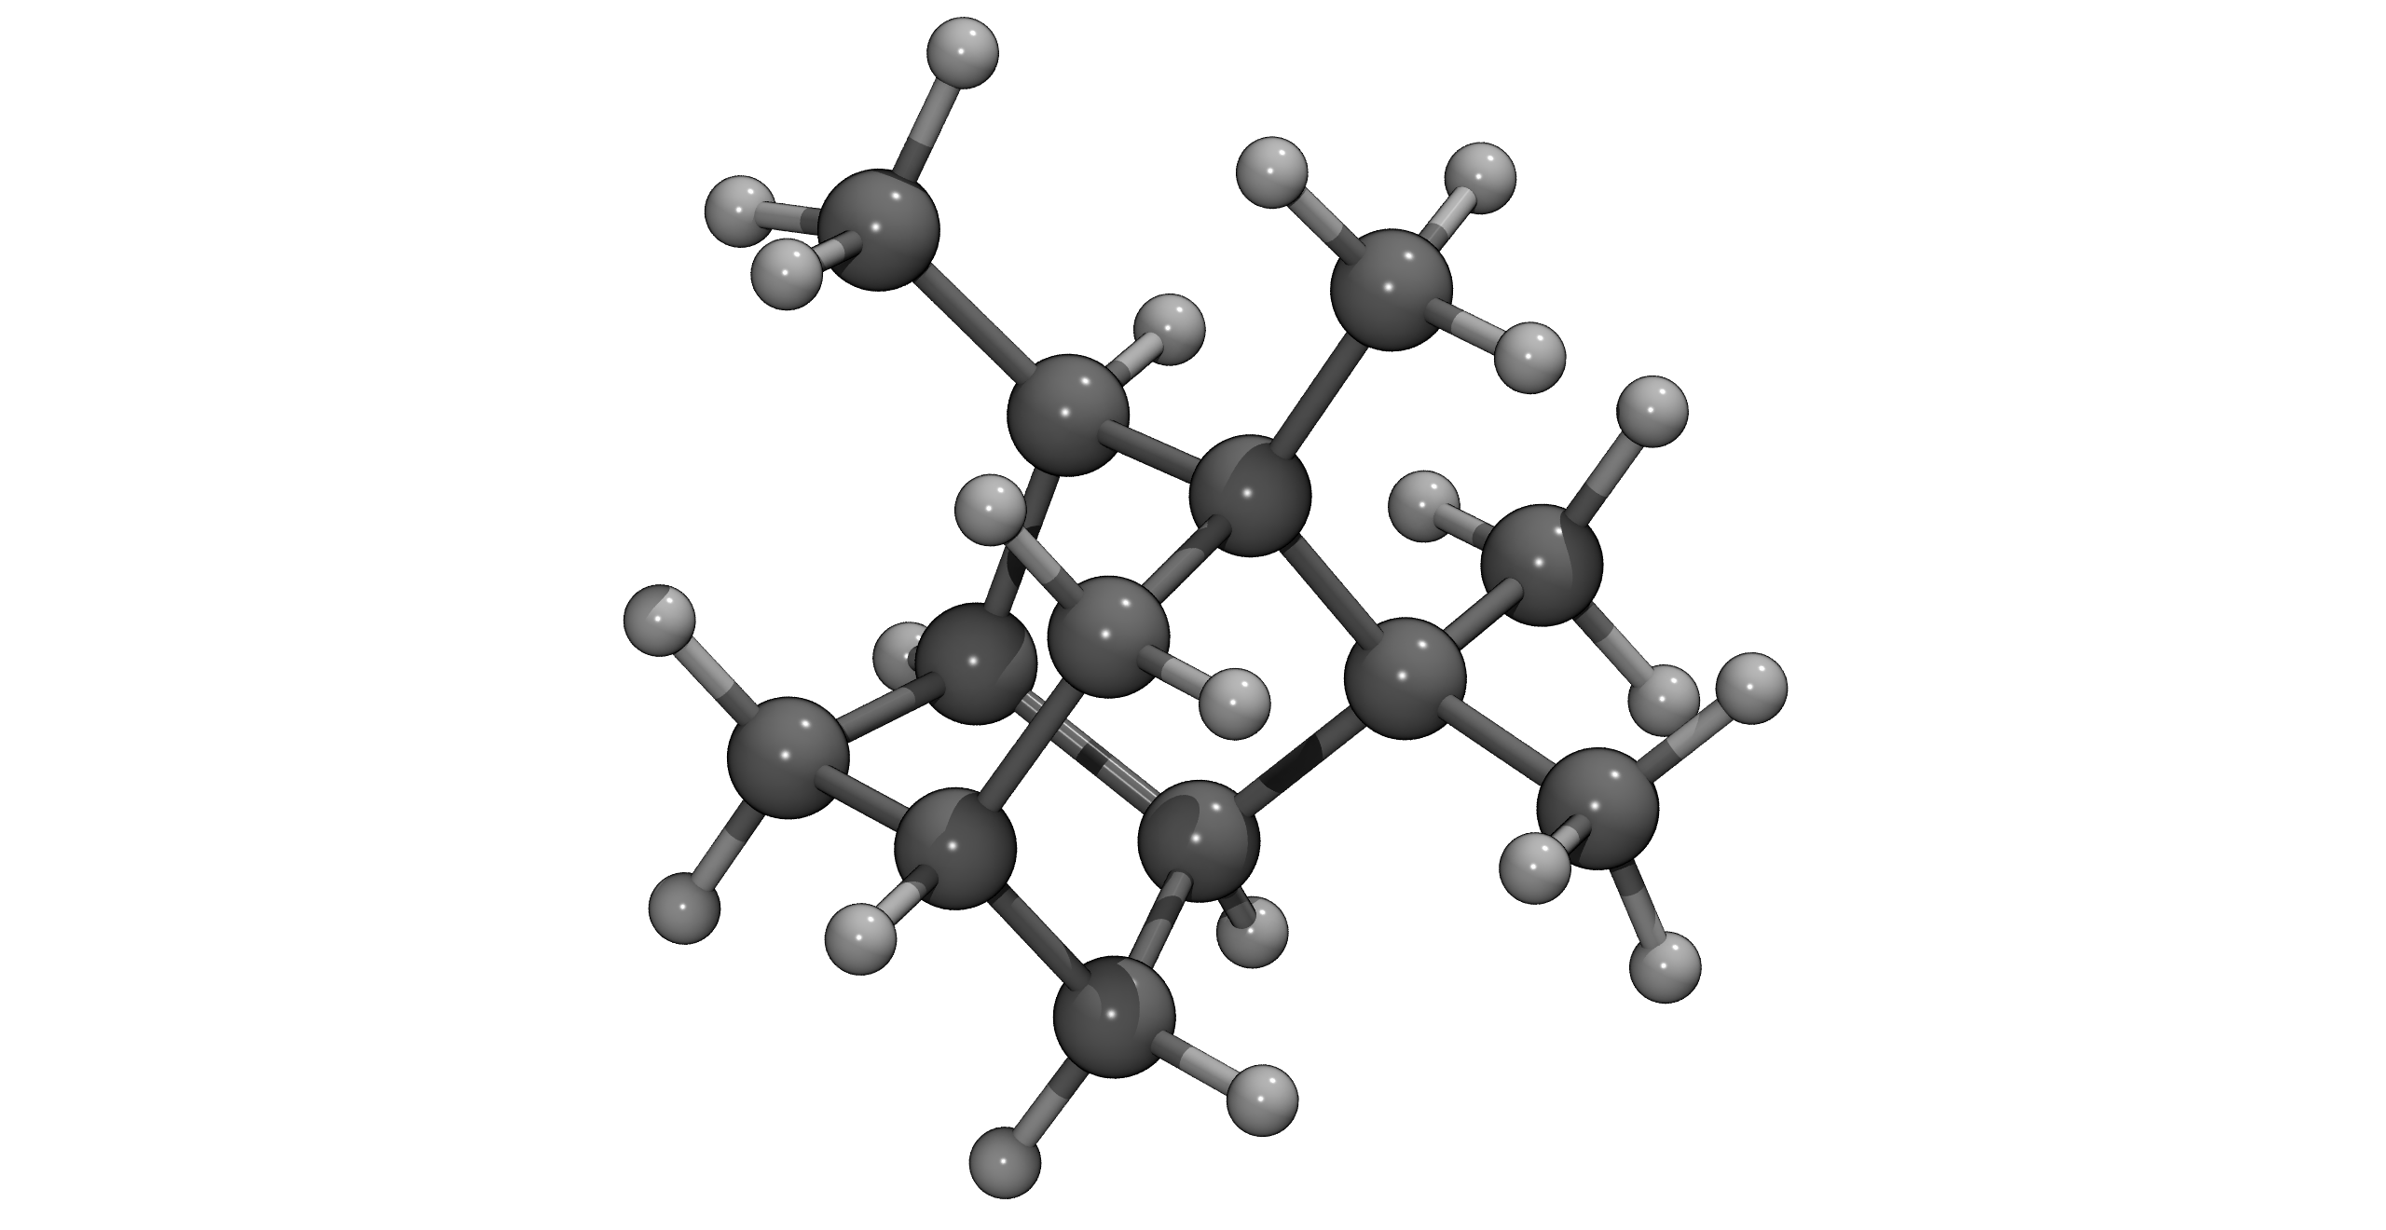
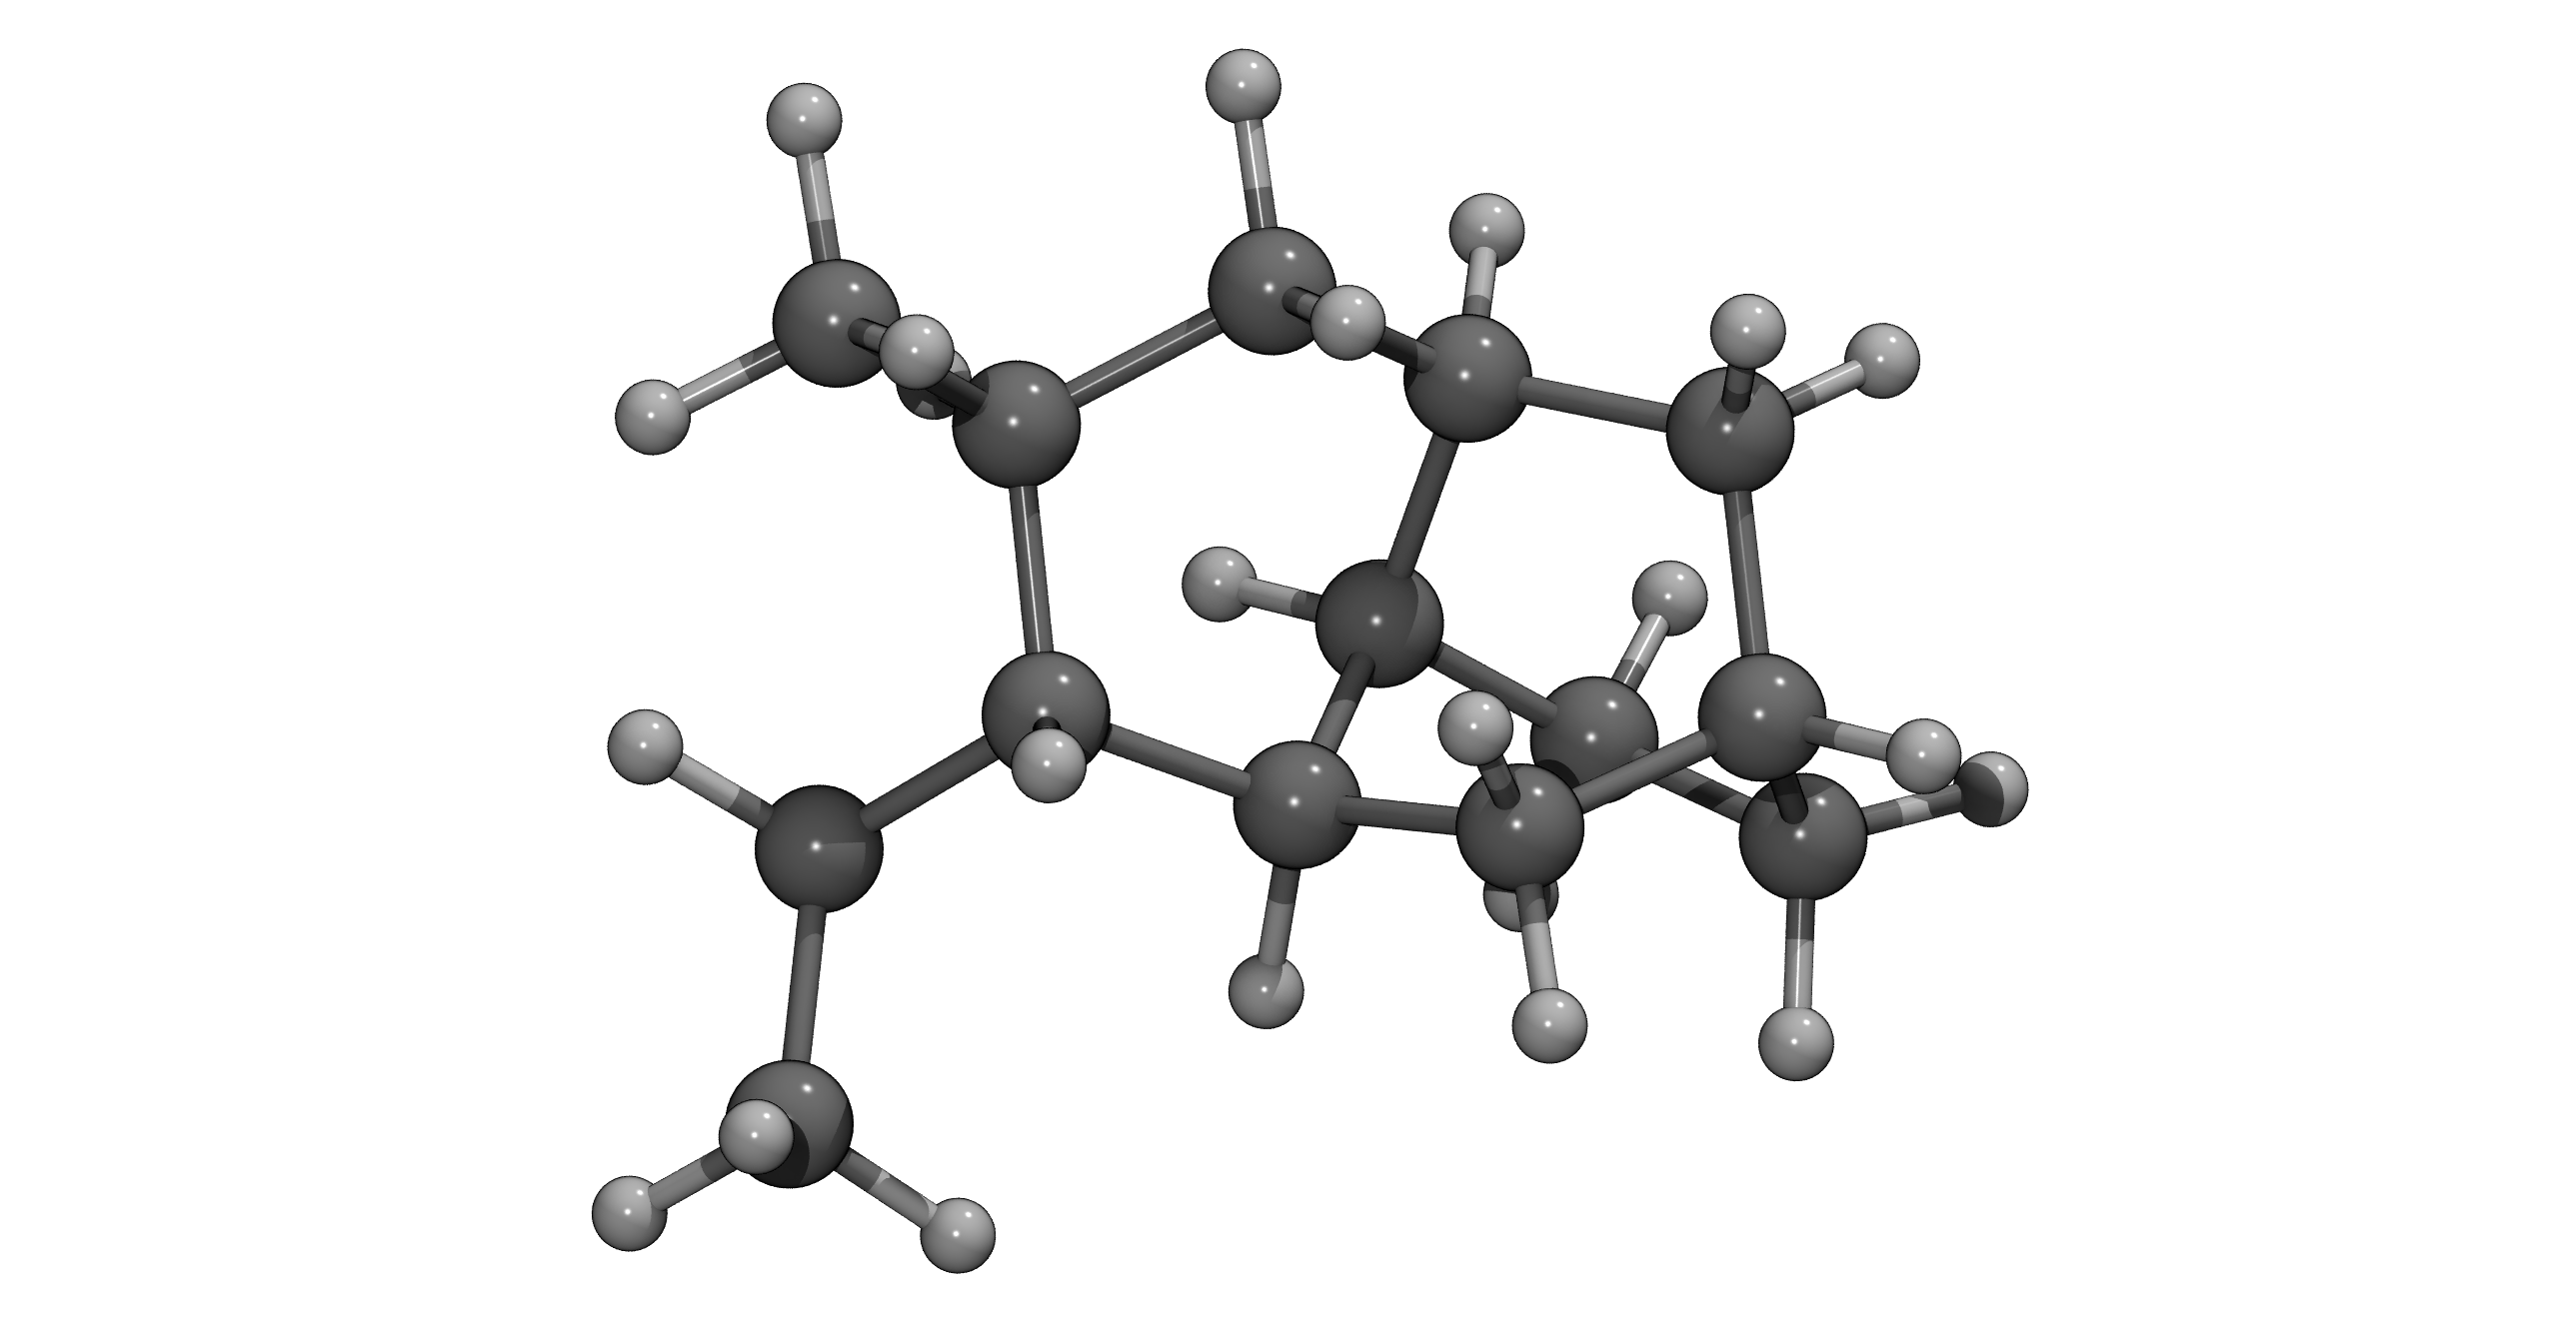
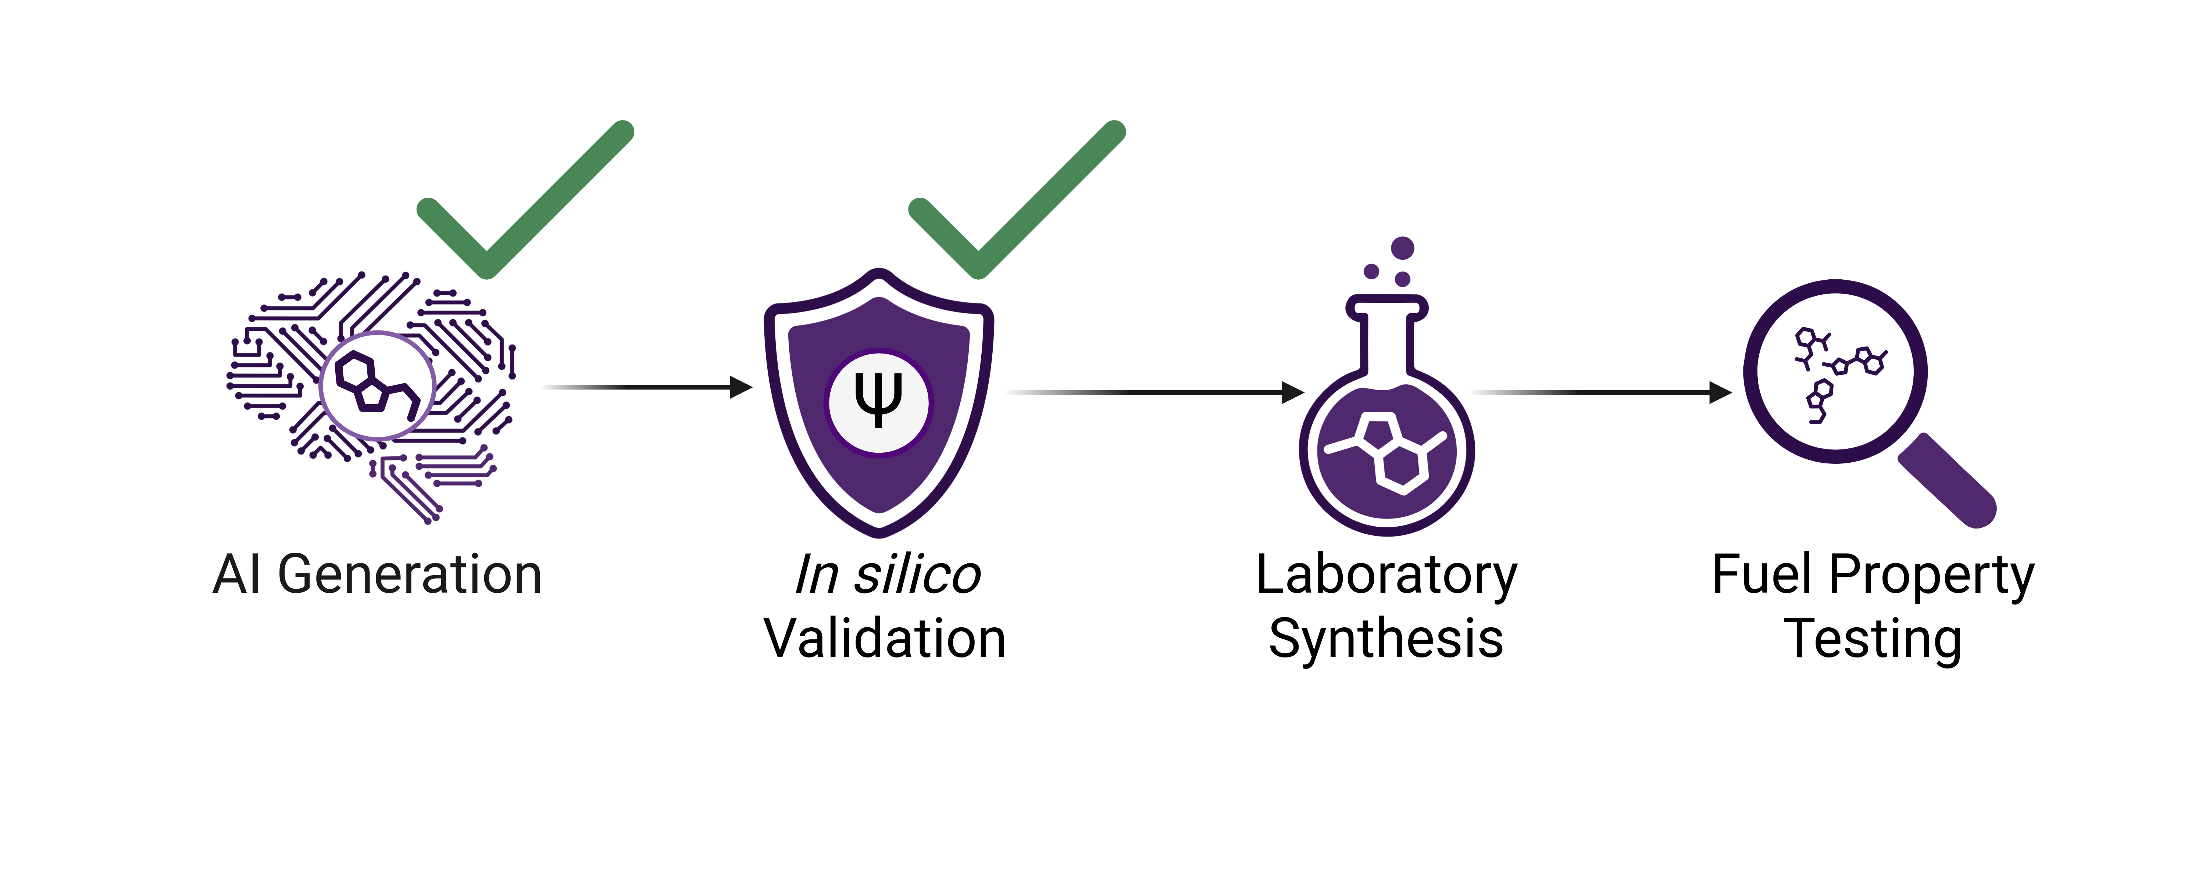
AI Can Generate Novel High-Energy Sustainable Aviation Fuel Molecules Karl I. Neivelt (LBDQ8) Supervisor: Dr Zied Hosni, Route: Data-Driven Innovation
Full Methods&Data:
1. Why Do Planes Need Better Fuel?
3. What Did We Discover?
Aviation = 2.5% global CO₂ [1] and demand is rising
Current sustainable aviation fuels (SAFs) are costly with inferior properties. Traditional fuel discovery is slow & expensive.
Generative AI is widely used in drug discovery, but only limited use for aviation fuel.
Fig. 3. Model metrics improve steadily during training (99 % CI shown).
Aim: Use Generative AI to design novel, high-energy, and sustainable fuel molecules.
AI learns to make better molecules: the model improved, producing highly valid, unique, and novel molecules with high predicted energy density.
2. How Can AI Design Molecules?
Fig. 1. Four-step methodology. DFT: density functional theory.
Fig. 4. Top candidate molecules after screening process. NHOC: net heat of combustion, SA: synthetic accessibility, FP: flash point.
Here, Generator and Discriminator consist of transformer encoders. The model also includes other heuristics to improve stability and diversity.
Systematic property filtering works: 10 000 generated molecules were filtered to top 250.
Fig. 5. 3D optimised structures of selected molecules.
Final candidates rival best aviation fuels: fuels in Fig. 5 exceed Jet-A in NHOC and pass the ASTM D7566 [3] requirements for all predicted properties.
Fig. 2. Schematic of the used Generative Adversarial Network (GAN). Model is based on TenGAN [2].
4. What is Next?
Our generation-screening workflow can produce high-quality SAF candidates.
Next steps: synthesis pathway analysis, synthesis of molecules and property testing.
References
[1] Ritchie H. What share of global CO₂ emissions come from aviation? Our World in Data. 2024 Apr 8 [cited 2025 Jul 23]. Available from: https://ourworldindata.org/global‑aviation‑emissions.
[2] Li C, Yamanishi Y. TenGAN: Pure transformer encoders make an efficient discrete GAN for de novo molecular generation. In: Dasgupta S, Mandt S, Li Y, editors. Proceedings of the 27th International Conference on Artificial Intelligence and Statistics; 2024 May 2-4; Valencia, Spain. Proceedings of Machine Learning Research. 2024;238:361‑369. Available from: https://proceedings.mlr.press/v238/li24d.html
[3] ASTM International. ASTM D7566‑24d: Standard Specification for Aviation Turbine Fuel Containing Synthesized Hydrocarbons. West Conshohocken (PA): ASTM International; 2024.

